Slide 1

Can You Afford a Home in Colorado?
A Simple Question from “I’m All Out of BubbleGum”
Claire Cleveland, Patrick Hanafin, Evan Kihn
Dennis Phan, & Joel Stucki

Slide 2
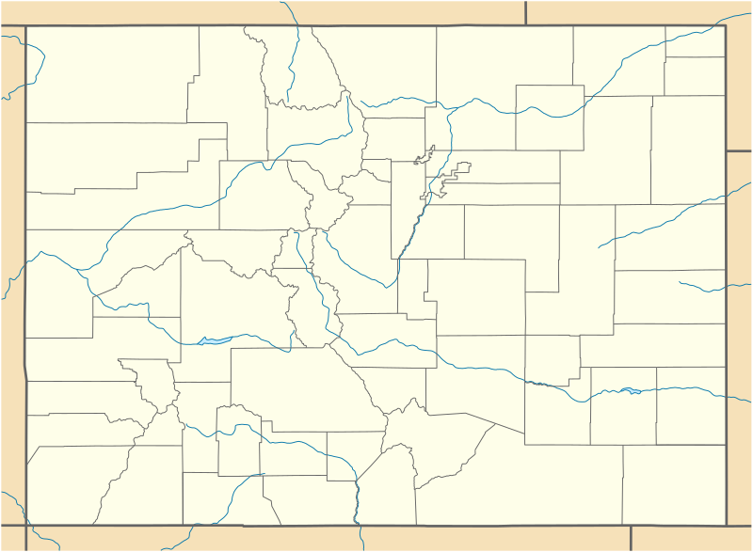
Who is priced out of the housing market in Colorado?
The population in Colorado continues to rise, which has put pressure on the housing market, causing home prices to increase. If the growth in housing prices outpaces the growth in income, more and more people will be unable to afford a home. We decided to explore where that threshold lies...

Slide 3


1. Data Sources
Multiple Sources of Data were used in our analysis.
zillow.com Third-Party housing data providing average home prices by county in Colorado
data.colorado.gov Governmental data providing personal income information by county in Colorado.
bea.gov Governmental data providing industry GDP information by county in Colorado.

Slide 4
Considering a good rule of thumb is that your monthly mortgage payment shouldn’t exceed 25% of gross income,
will your gross income accommodate the average home in the county that you’d like to live in?
Tip
Currently, in the State of Colorado, the average household income is $65,458 per month.
The average home price is $267,924

Slide 5
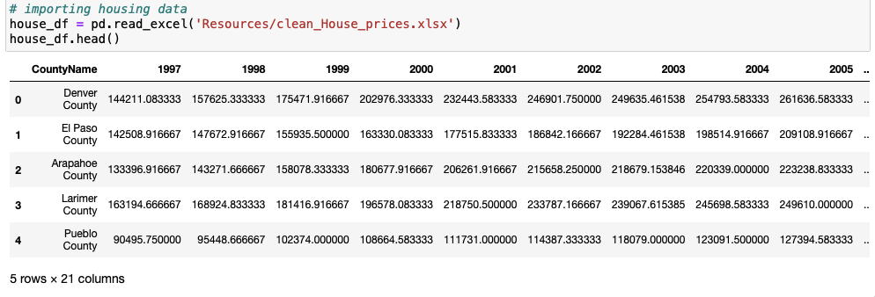
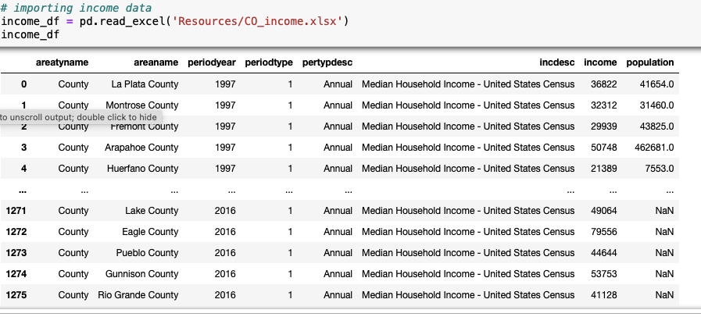
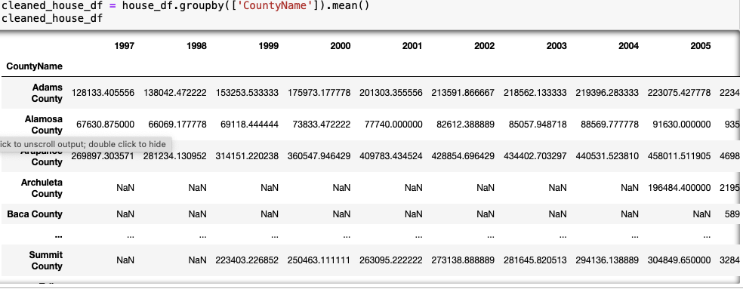
Evolution of The Data
Description
Data was imported and cleaned so it could be merged together to accommodate the machine learning model.

Slide 6
2. Technologies
The following technologies were used throughout the project.
Excel Used as a part of Data cleaning
Jupyter Notebook Used for Data cleaning, analysis, and machine learning
PGAdmin Database development

